Slide 1

Construct Validity
Dr Oliver Clark [Oli]

Slide 2
Three Videos
1 Introduction to Construct Validity
Difference between Construct Validity and the other validities
Measurement Schmeasurement
2 Nomological Networks
A load of lawlike things
3 Other considerations
Jingle Jangle Fallacies
Convergent and Divergent validity

Slide 3

Construct Validity
”…is ordinarily studied when the tester has no definite criterion measure of the quality with which [they] are concerned, and must use indirect measures...
…here the trait or quality underlying the test is of central importance, rather than either the test behaviour or the scores on the criteria" [APA Committee on Test Standards, 1954, p14]

Slide 4
Construct Validity
Identify a construct
Define the construct
Develop a theory about the structure of the construct
How many factors are present
How they are related
Select a means of measuring the construct (e.g., Likert-type scales)
Establish that the measure appropriately represents the construct.
Rape Myth Acceptance
Flake, Pek, Hehman (2017)

Slide 5
Construct Validity
Identify a construct
Define Construct
“…to trivialise and minimise the scope and impact of sexual assault, and encompasses widely held, but ultimately false stereotypical perceptions of rape and victims …” Persson & Clark (2021)
Flake, Pek, Hehman (2017)

Slide 6
Construct Validity
Identify a construct
Define the construct
Develop a theory about the structure of the construct
How many factors are present
How they are related
Rape Myth Acceptance
IRMAS:
- One major factor
- 6 sub factors
- Positively correlated
Flake, Pek, Hehman (2017)

Slide 7
Construct Validity
Identify a construct
Define the construct
Develop a theory about the structure of the construct
How many factors are present
How they are related
Select a means of measuring the construct (e.g., Likert-type scales)
Establish that the measure appropriately represents the construct.
Flake, Pek, Hehman (2017)

Slide 8
Construct Validity Flake et al (2017)
Phase | Validity Evidence | Description
Substantive | Literature review and construct conceptualization | Identifying depth and breadth of construct (Gehlbach & Brinkworth, 2011)
 | Item development and scaling selection | Expert review (Gehlbach & Brinkworth, 2011)
 | Content relevance and representativeness | Item mapping (Dawis, 1987), focus groups, and cognitive interviewing (i.e., think aloud; Willis, 2004), investigate construct under representation or irrelevancy (i.e., content validity; Sireci, 1998)
Structural | Item Analysis | Response distributions, item–total correlations, and difficulty
 | Factor Analysis | Exploratory and confirmatory analyses including structural equation models and item response theory
 | Reliability | Coefficients: 𝞪 and ɷ (Mcdonald, 1999); interitem correlations, test–retest (McCrae, Kurtz, Yamagata, & Terracciano, 2011), dependability (Chmielewski & Watson, 2009)
 | Measurement invariance (i.e.,differential item functioning) testing | Multiple group factor analysis,item response theory, and differential item functioning tests (Millsap, 2011)
External | Convergent and discriminant | Correlations between other scales meant to capture similar and different constructs, multitrait-multi method matrix analyses (Campbell & Fiske, 1959)
 | Predictive/criterion | Regressions on criterion variables of import
 | Known groups | Detecting differences between groups known to differ on construct

Slide 9
Measurement Schmeasurement
Question | Information to report
1. What is your construct? | Define the construct
 | Describe theories and research supporting the construct
2. Why and how did you select | Justify the measure selection
your measure? | Report existing validity evidence
3. What measure did you use to | Describe the measure and administration procedure
operationalize the construct? | Match the measure to the construct
4. How did you | Describe response coding and transformation
quantify your measure? | Report the items or stimuli included in each score
 | Describe the calculation of scores
 | Describe all conducted (e.g., psychometric) analyses
5. Did you modify the scale? | Describe any modifications
And if so, how and why? | Indicate if modifications occurred before or after data collection
 | Provide justification for modifications
6. Did you create a measure | Justify why you did not use an existing measure
on the fly? | Report all measurement details for the new measure
 | Describe all available validity evidence; if there is no evidence, report that
#JUSTSAYING
Flake & Fried (2020)

Slide 10
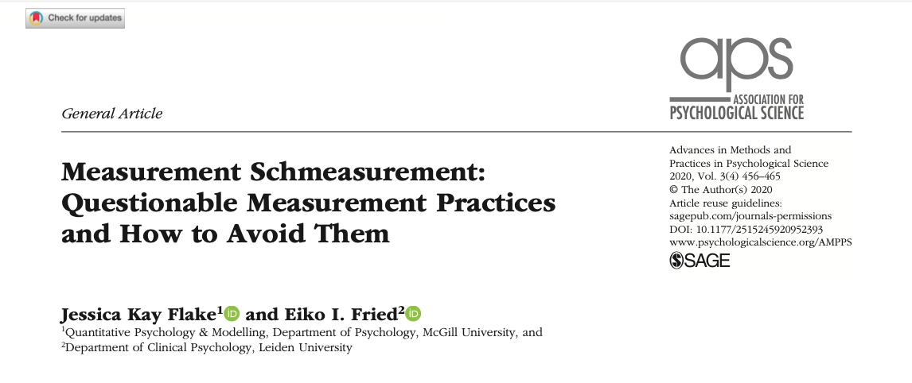
Measurement Schmeasurement

